Slide 1

ECONOMICS · GRADE IX
LIMITATIONS OF GOVERNMENT INTERVENTION
When good intentions produce unintended consequences.
Can a policy designed to help people end up creating a new problem?
Notes:
Government policies often begin with a sensible aim: helping people. The question is whether the way a policy works can create another difficulty. Emphasise “unintended”: a harmful effect need not be deliberate. Start by looking at the balance every intervention must consider.

Slide 2
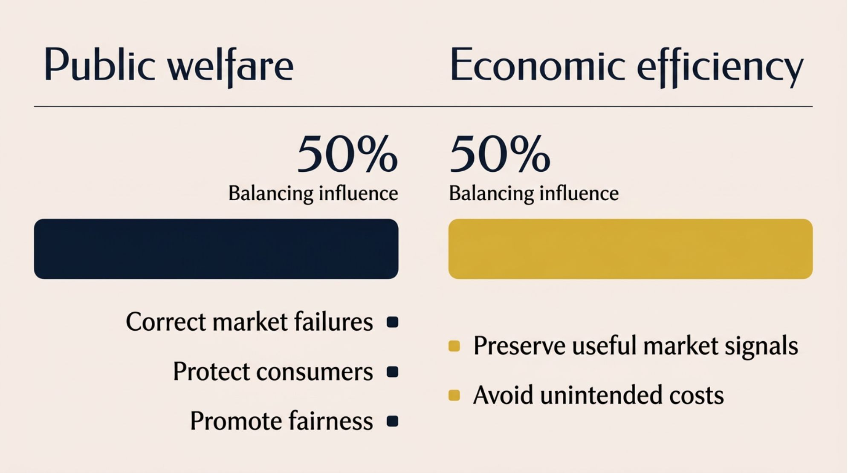
Limitations of Government Intervention
THE ECONOMIC PARADOX
The economic paradox: fixing one problem can create another
Good aims need good design.
Poorly designed or excessive intervention can distort signals and create unintended costs.
The real question is not whether government should intervene, but how wisely it should do so.
Notes:
Markets can fail, so intervention can be valuable. But people respond to the incentives a policy creates, not only its intentions. Emphasise that welfare and efficiency both matter. A hypothetical wheat price shows how the aim of affordability can meet a supply problem.

Slide 3
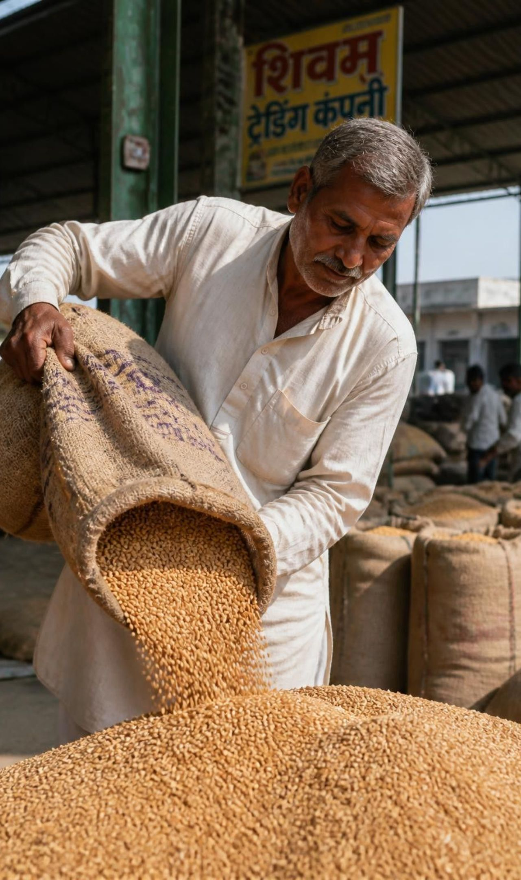
Limitations of Government Intervention
PRICE DISTORTIONS · HYPOTHETICAL WHEAT EXAMPLE
When a lower price weakens the signal
MARKET PRICE
CONTROLLED MAXIMUM
₹30/kg
₹20/kg
₹10/kg difference
Below equilibrium, buyers may want more wheat while sellers offer less. Lower permitted revenue can weaken supply incentives.
Possible result: excess demand and shortages. Costs, demand, and complementary policies affect the outcome.
Economics Presentation · Grade IX
Notes:
These prices are hypothetical, not a report about an actual wheat policy. Assume ₹30 is the equilibrium price. At a ₹20 ceiling, wheat becomes cheaper for buyers, but selling it may become less attractive for producers. Emphasise “may”: shortage depends on the circumstances. Price is one signal; procedures can create a different kind of barrier.

Slide 4

Limitations of Government Intervention
COMPLIANCE BURDENS
When paperwork becomes a barrier to progress
Regulation protects food safety, fire prevention, workers, and the environment.
01
02
03
Complex procedures
Higher burden
Possible delays
More time and administrative costs
Small firms can be hit harder
Opening or expansion slows
The issue is excessive complexity and disproportionate cost, rather than regulation itself.
Notes:
A restaurant needs genuine safety standards. The difficulty arises when procedures overlap or become unnecessarily complicated. A small owner has less money and staff to absorb those costs. Emphasise that simpler administration can preserve protection. Next, consider how uncertain returns influence investment in the future.

Slide 5
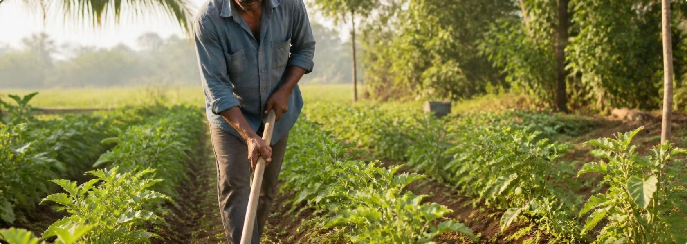
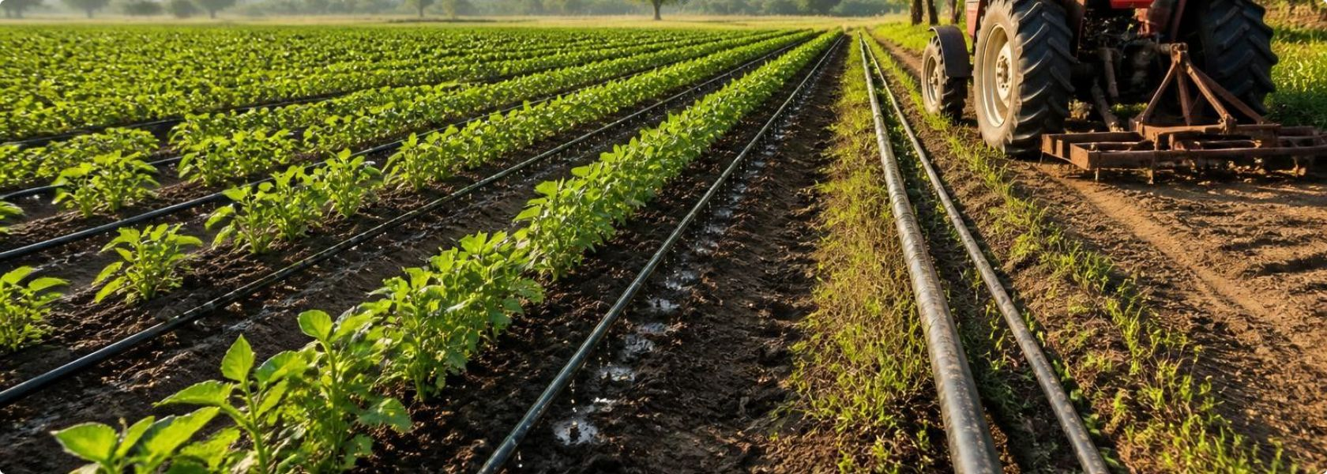
Limitations of Government Intervention
INVESTMENT AND INNOVATION
When the future becomes too expensive to build
Traditional techniques
Precision irrigation and modern equipment
01
02
03
04
Uncertain returns
Weaker investment incentives
Slower technology adoption
Potentially weaker productivity
Better seeds, irrigation, equipment, and efficient techniques need investment. These effects are possible, not inevitable: policy design and the wider economy matter.
Notes:
A farmer considers future earnings before paying for better seeds or equipment. If expected returns are inadequate or uncertain, that investment may be postponed. The pictures show possibilities, not a guaranteed transformation. Emphasise “incentives to invest”. These examples now come together in one underlying challenge.

Slide 6
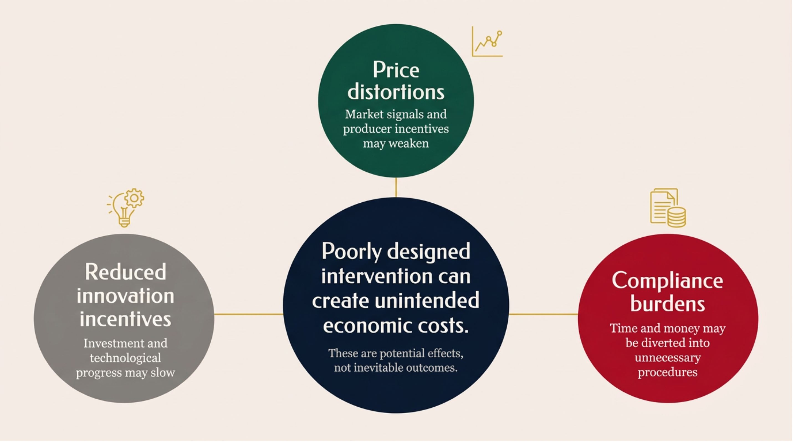
Limitations of Government Intervention
THE SHARED CHALLENGE
Three limitations. One underlying challenge.
Notes:
The three limitations affect different decisions: what to supply, how to operate, and whether to invest. All can arise when policy overlooks how people respond. Emphasise “poorly designed”, rather than government action in general. The answer is to improve policy design, not automatically remove intervention.

Slide 7
Limitations of Government Intervention
BETTER POLICY DESIGN
Smarter, not simply less, government
Proportionate regulation
Well-designed price policies
Support for innovation
Protect the public without unnecessary burdens.
Consider incentives, supply responses, and unintended consequences.
Help farmers and businesses invest, improve productivity, and adopt better technology.
Public protection and economic opportunity belong in the same policy.
The goal is effective, proportionate, thoughtfully designed intervention, rather than eliminating it.
Notes:
These three pillars balance protection with the ability to produce and improve. A government can simplify procedures without weakening safety, and support affordability while considering supply. Emphasise “smarter”. Return to our central question: how can helping people today preserve their opportunities tomorrow?

Slide 8
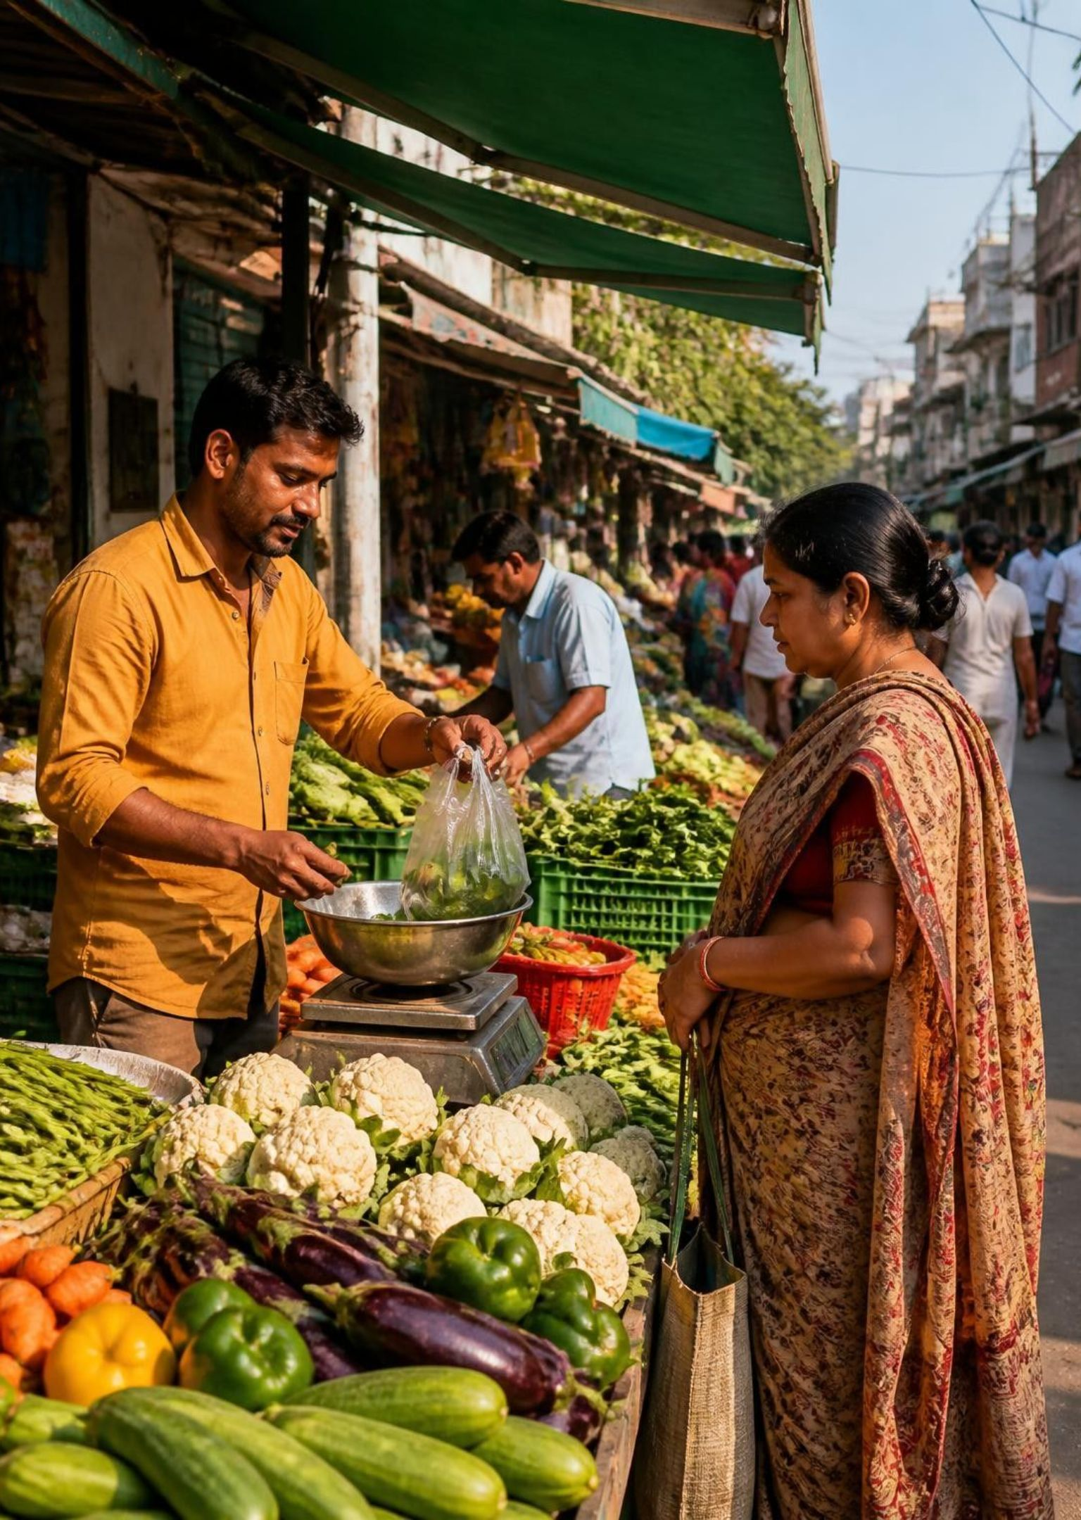
THE QUESTION TO TAKE FORWARD
Good policy does more than solve today’s problem.
It must also consider the incentives, opportunities, and unintended consequences it may create tomorrow.
How can we protect society without unintentionally holding back the very people we want to help?
Thank You
Notes:
Pause after the title. A policy should be judged by both its immediate benefit and the responses it encourages over time. Emphasise “tomorrow”. Finish with the question, thank the audience, and invite discussion about how protection and opportunity can work together.

